Slide 1
Project 3 Notes
Big Data Technology

Slide 2
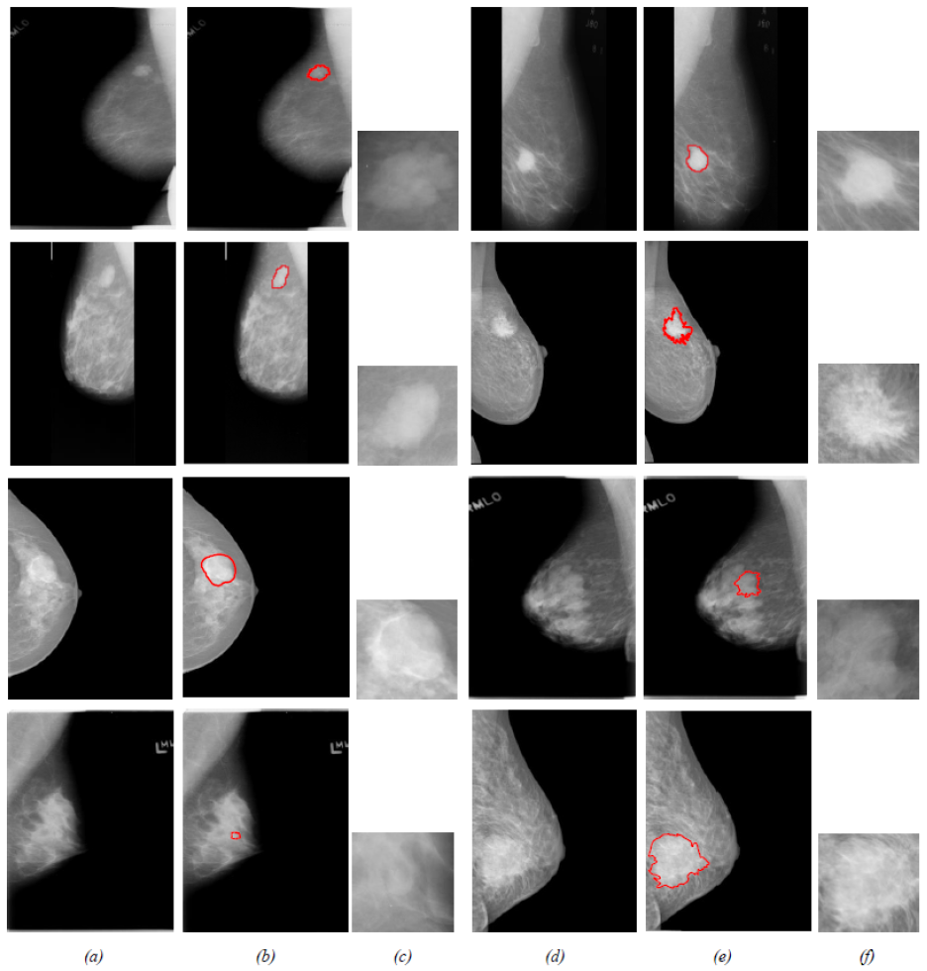
Detected tumor regions

Slide 3
Questions one to five
Classifiers: Decision Tree, Support Vector Machine (RBF, Polynomial)
Model
Matrix with dimension of 570 rows x 32 columns
Training Set
(80%)
CSV File
Train
Classifier
Trained
Classifier
Read into Panda
Data Split
y_test
Performance Metrics
Accuracy
Sensitivity
Specificity
Q1
Testing Set
(20%)
Trained
Classifier
y_pred
Q2: Remove any
bad data points
y_pred
Is a column vector with length of number of data points in your testing set
y_pred = [M, M, … , B, … , M]’
y_pred = [1, 1, … , 0, … , 1]’

Slide 4
Questions Six
Do for N = 1, 4 and 10
Classifiers: Decision Tree, Support Vector Machine (RBF, Polynomial)
Model
Matrix with dimension of 570 rows x 32 columns
Matrix with dimension of 570 rows x (32-N) columns
Training Set
(80%)
Train
Classifier
Trained
Classifier
Remove N number of columns
Track the training time
Performance Metrics
Accuracy
Sensitivity
Specificity
Data Split
y_test
Testing Set
(20%)
Trained
Classifier
y_pred
Q2: Remove any
bad data points
y_pred
Is a column vector with length of number of data points in your testing set
y_pred = [M, M, … , B, … , M]’
y_pred = [1, 1, … , 0, … , 1]’

Slide 5
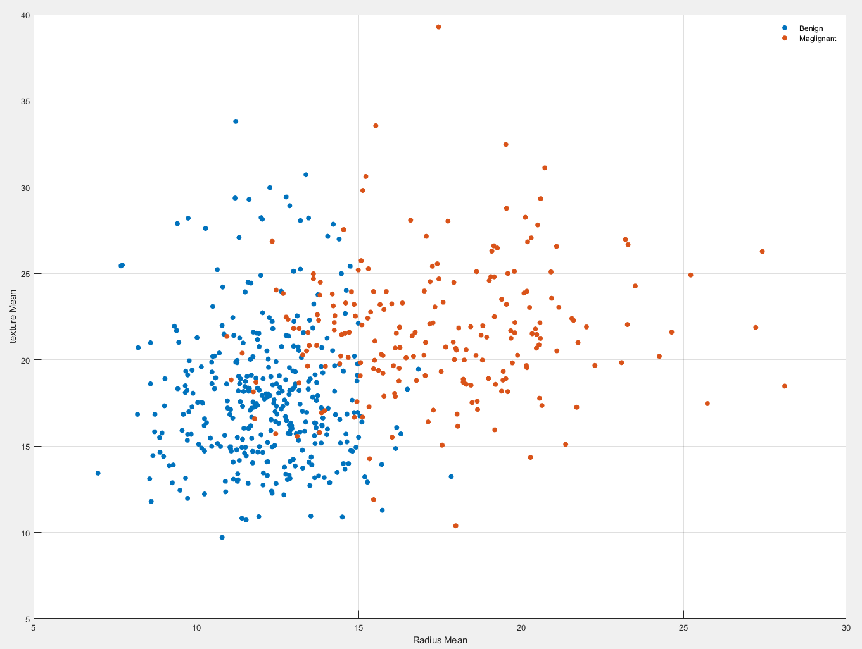
Class Separation

Slide 6
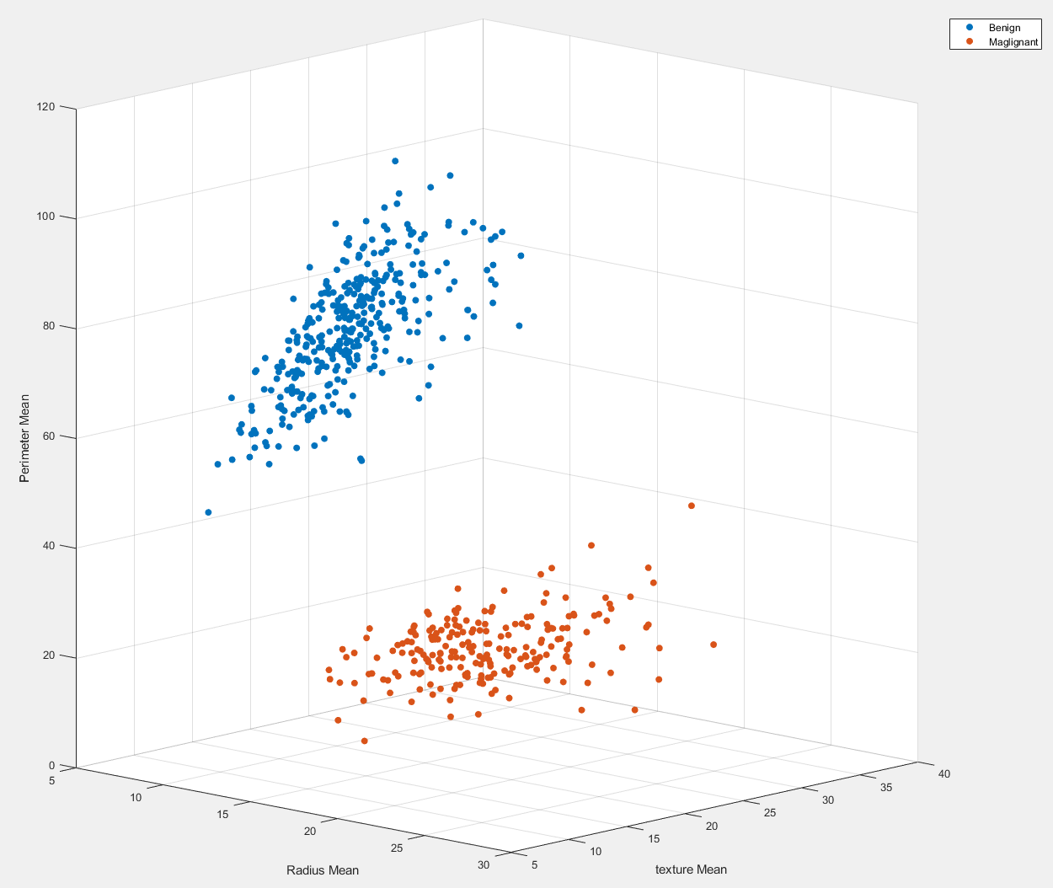
Class Separation

